Slide 1
Network Administration
Network
  Two or more than two network devices connect/interconnect with each other for the purpose of communication
Remember
  Interconnecting devices on basis of hardware
  Communication on basis of software
  No hardware, no connectivity
  No software, no communication

Slide 2
Network Administration
Why Networks?
  Sharing information
  Sharing resources
  Sharing applications

Slide 3
Network Administration
HUB
  HUB is physical layer device of OSI reference model
  It is used as a central device that connect many devices
  HUB is a broadcast device, it means it always broadcast
  HUB is a just Hardware
  It is connecting device
  Security problem with HUB

Slide 4
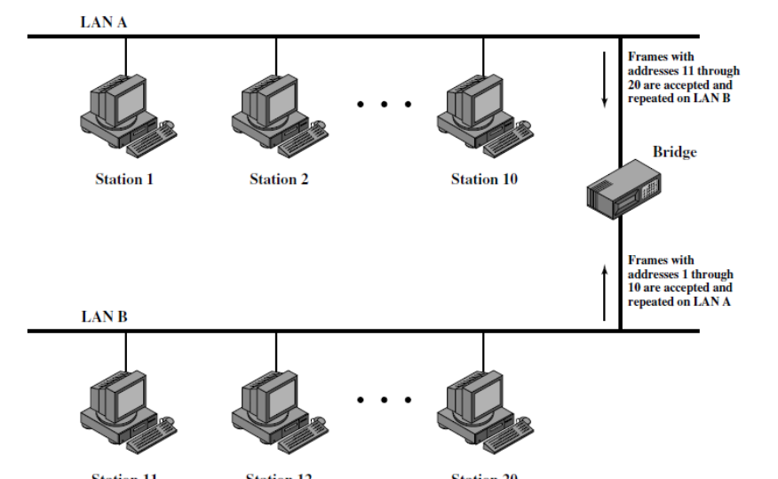
Network Administration
BRIDGES
  Layer 2 device of OSI reference model
  Bridges has a table that called bridging table
  Mostly bridges has two ports that connect different segments of network
  Bridge isolates collision domains since it buffers frames

Slide 5
Network Administration
Switch
  It is also used as central device
  Switch consist of “Hardware + Software”
  It is intelligent device
  All intelligent devices has its own table
  Switch is a intelligent device, so it also has a table called “switching or MAC address table”
  Switch every time (when frame comes) consult to its table
    If destination address present, it unicast frame
    If destination address not present, it broadcast frame

Slide 6
Network Administration
Switch
  Mostly switches are layer 2 device of OSI reference model
Router
  Integrate LAN & WAN
  Connected different networks and forward one network traffic to other network
  It is unicast device for data
  it Has routing table where kept entries of destination networks
  If destination network address present in table then unicast otherwise discard
  Layer 3 device of OSI reference model

Slide 7
Network Administration
Collision Domain
  The area of network where any two or more network devices send data at same time and the chance of data to be collision
Broadcast Domain
  The area of network where any one network device sent a broadcast frame and get the copy of that frame all network devices in that area

